Slide 1
Laboratory Safety

Slide 2
EHS Policy Statement
SUNY Polytechnic Institute is committed to:
Protecting the health and safety of it’s employees, partners, customers and public
Protecting the environment
Complying with regulatory standards
Notes:
Emphasize that not all information is covered in detail.
It is important that the employees supervisor and or manager do a follow-up with the needed details and or specifics related to the job and tasks at hand.

Slide 3
Employee Responsibilities
All individuals are responsible for safety at SUNY Poly
Take an active role in your safety and the safety of others
Plan and perform tasks in a safe manner
Follow SUNY Poly safety policies and procedures
Understand the potential hazards you may be exposed to
Contact your manager if you feel you need additional safety training
Notes:
Take the time to understand and educate yourself in area hazards and tasks.
Responsibility should not just be limited to oneself but to assist and communicate to others if there are hazards and concerns in the area.
Instructors Notes
Objective: All employees need to work together to achieve this objective

Slide 4
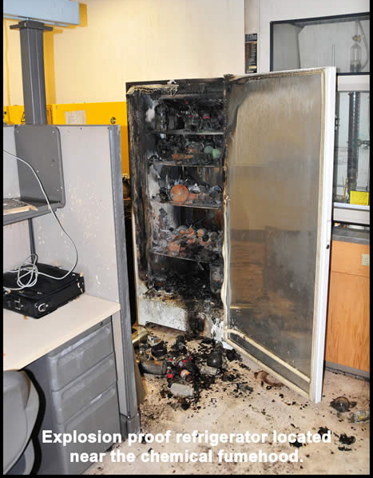
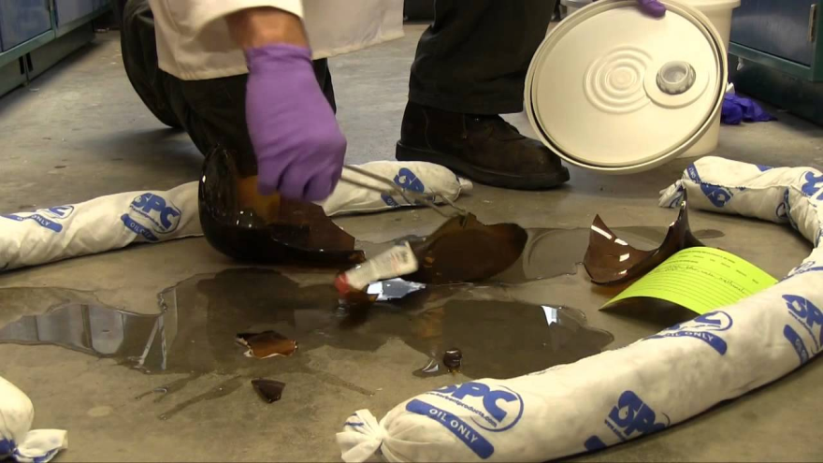
Hazards in Laboratories
Fires or Explosions
Chemicals Spills or Releases
Electrical/Mechanical
Biological Agents
Radiation
Exposure to hazardous materials via:
Inhalation
Skin absorption
Injection
Ingestion

Slide 5
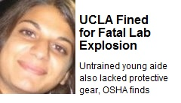
Case Study: UCLA Fatality
Sheri Sanghi
UCLA Research Associate
On Dec. 29, 2008 was working with a pyrophoric chemical.
The material spilled and ignited
She received 3rd degree burns to 50% of her body
She was not wearing a lab coat.
Her polyester sweater burst into flames
Coworker didn’t bring her to the safety shower
Sheri died 18 days later
Sheri was not told she had to wear a lab coat (flame resistant)

Slide 6
Obtaining Chemicals
Approved Chemical List
On EHS Intranet Site
Use the HazMin Database
Chemical Approval Process
Must obtain an SDS (Safety Data Sheet)
Fill out HazMin request form and
submit with SDS to EHS
If material is hazardous may require that an SOP be developed
Once approved, you can order the chemical

Slide 7
Safety Data Sheets (SDSs)
SDS’s contain safety information including:
Physical/chemical properties (pH, flash point, etc.)
Toxicity and incompatibility data
Storage and shipping requirements
Required PPE
Emergency response procedures
NFPA Codes
GHS pictograms

Slide 8
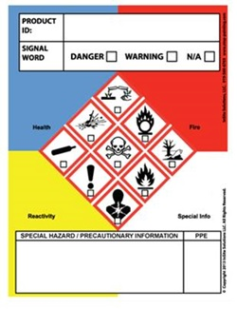
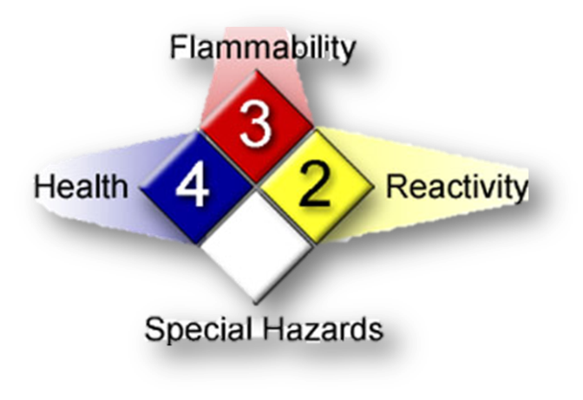
Chemical Labels
Chemicals from suppliers must be labeled
Do not remove or deface mfg. labels
Secondary containers must be labeled with chemical name and hazard warning
May use: NFPA or GHS label

Slide 9
Chemical Hygiene Plan (CHP) (CHP)
EHS-00082 Policy for Chemical Hygiene Plan
Complies with OSHA Std. 29CFR1910.1450 – available on Intranet
Guidance on storage and handling of chemicals in laboratories
If rated 3 or greater in NFPA the material is a HPM (Hazardous Process Material) and may require a lab specific SOP (Standard Operating Procedure)

Slide 10
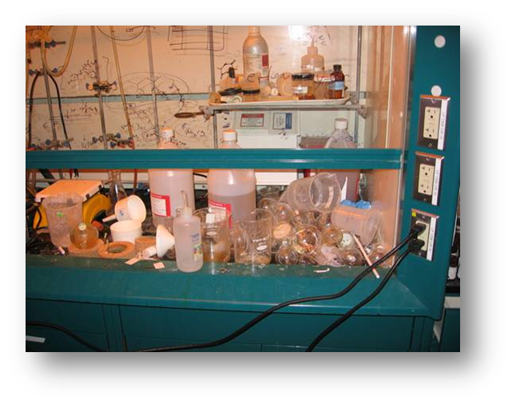
Good Laboratory Practice
Engineering Controls: Chemical Fume Hoods
Use for handling hazardous chemicals
Check that it has a current annual air flow test label
Work at least 6” in from the edge of the hood
Keep head/body outside of hood
Lower sash when working in hood; keep down throughout work
Do not clutter
When used correctly and
maintained, excellent control for
removing hazardous air
contaminants.
Bad Hood!

Slide 11
Good Laboratory Practice
Engineering Controls: Other Controls
Biological Safety Cabinet (BSC)
Sterile environment for biologicals, not for chemicals
Filters air, not for volatile chemicals
Gas Cabinet
Ventilated enclosure for hazardous compressed gases
Glovebox or Glovebag
Inert environment for pyrophoric or water reactive chemicals
Inerting atmospheres
For pyrophoric or water reactive chemicals
Interlocks
Face shield, goggles
All of these work by keeping a barrier between you and the hazardous material!

Slide 12
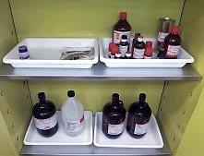
Good Laboratory Practice
Storage of Chemicals:
Use the least hazardous material possible
Do not stockpile chemicals, use
small quantities
Keep closed/covered when not in
use
Proper storage of chemicals
Store (and segregate) by hazard classification
Flammables: Flammable Storage cabinet or fridge
Corrosives – Acid/Base Storage cabinet
Oxidizers – away from flammables
Check SDS for storage requirements, i.e. temperature, light
1st in 1st out – use oldest chemicals first

Slide 13
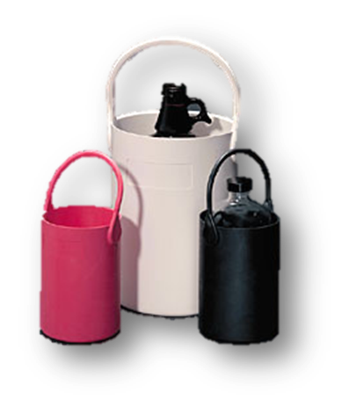
Good Laboratory Practice
Transferring Chemicals:
Use appropriate PPE; Gloves, safety glasses, arm guards, apron, face shield
Use local exhaust ventilation (hood, snorkel)
Keep away from ignition sources - flammable substances
If mixing solutions- ensure that the chemicals are compatible and proper mixing protocols are established
Transporting Chemicals:
Use cart and/or secondary
containment (bottle carriers)

Slide 14
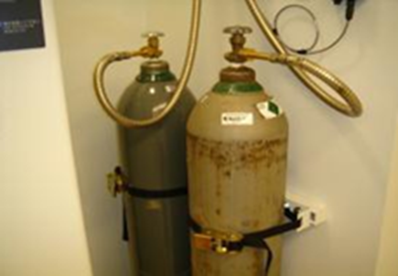
Good Laboratory Practice s
Compressed Gases:
Secure in an upright position, strap or chain about 2/3 up from bottom of cylinder
Protect from damage or tipping
If not in use, protective cap over neck
Use status tag to indicate: Full, In use or empty
Contact AcademicESG@sunypoly.edu to remove when empty
Do not store/use incompatible gases next to each other

Slide 15
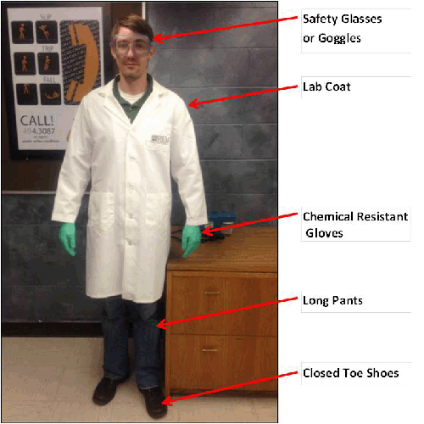
Good Laboratory Practice
Personal Protective Equipment (PPE):
Required Laboratory PPE
Lab Coat * and Eye & Face Protection*
(*When handling or immediately adjacent to someone handling chemicals.)
Gloves (Minimum of chemical resistant gloves)
Closed toe and heel shoes
Additional PPE required based
upon task:
Face shield and/or goggles
Apron, arm covers
Flame resistant lab coat
Chemical gloves (i.e. TRIonics)
Always check PPE prior to use!

Slide 16
PPE - Eye and Face Protection
Personal Protective Equipment (PPE):
Eye and Face Protection
Eye protection (e.g., safety glasses, goggles) and face protection (e.g., face shield) is required to be worn in posted areas and during tasks that create eye and/or face hazards.
Safety glasses with side shields are required to be worn to protect the eyes from flying particles, objects, chips, etc.
Goggles are required to be worn to protect the eyes from corrosive chemical (e.g., acid, base) splash hazards, dust hazards, etc.
Under face shields, safety glasses with side shields or goggles must also be worn depending on the type of hazard.
Although safety glasses must always be worn in laboratories, the following tasks are considered exempt from the safety glasses requirement. The intention of these exemptions is to permit those that are performing such tasks to temporarily allow them to remove their safety glasses:
In research or teaching labs while: working in front of a computer terminal (providing there is no eye hazard), chemical and/or infectious material contact or exposure.
Always check PPE prior to use!

Slide 17
Good Laboratory Practice
Why wear a lab coat?
If splashed, can quickly remove lab coat
Removing outer layer of clothing reduces chemical contamination by ~80%
Protects your clothing from destructive chemicals (dyes, corrosives)

Slide 18
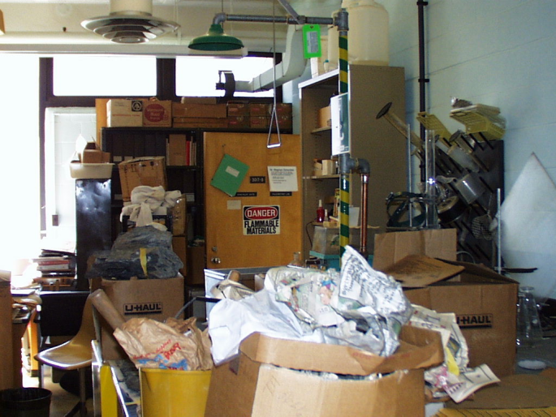
Good Laboratory Practice
Housekeeping and Hygiene:
Keep a clean work area
No eating or drinking in lab
Clean up incidental spills
Use disposable spill pads or trays to contain spilled material
Clean surfaces with:
Water
70% Ethanol (in BSC)
10% Bleach

Slide 19
Good Laboratory Practice
Housekeeping and Hygiene:
Hand Hygiene
Design experiments to limit touching chemicals
Change nitrile gloves frequently, especially if chemicals contact gloves
Nitrile are for incidental contact, not direct contact
Wash hands when changing gloves
Prevents unintentional ingestion or skin contamination
Prevents disease transmission (i.e. cold & flu)!

Slide 20
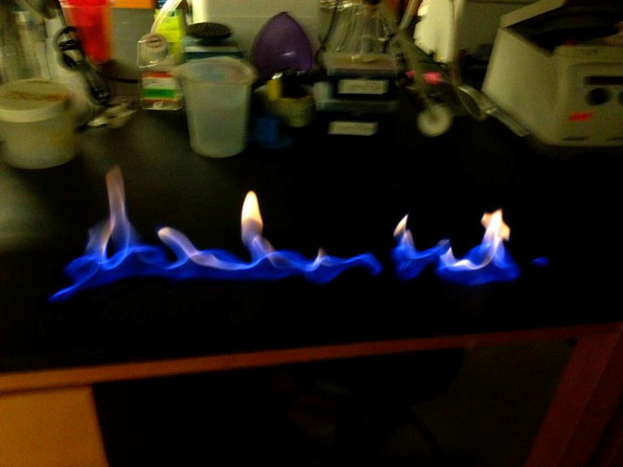
Emergency Procedures
Any lab emergency
Evacuate lab (if necessary)
Call Security at (518) 437-8600
Wait for ERTs to respond
Panic Button in NFE labs
Fire: RACE
Rescue – Get yourself and others out of danger
Alarm – Activate fire alarm, pull station by exit doors
Contain – Close doors to room
or area on fire
Evacuate – Go to Rally Point.

Slide 21
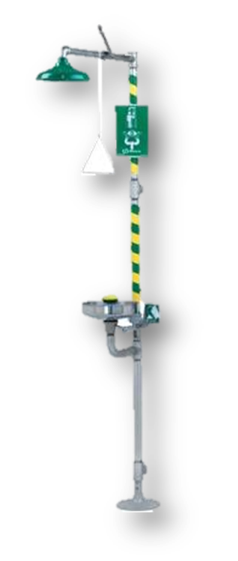
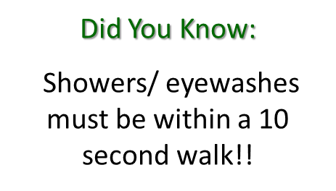
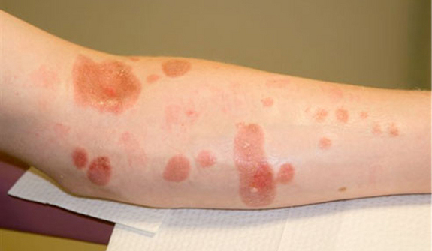
Emergency Procedures
Chemical Splash
Call Security
If a person has chemical on them-
Assist them to the shower/eyewash
Remove contaminated clothing
Wash for a minimum of 15 minutes
ERTs will respond and provide
1st aid and arrange for
transport to hospital

Slide 22
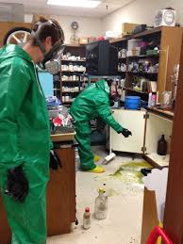
Emergency Procedures
Chemical Spill – Significant:
Significant ≥ 1pint or highly hazardous material
Call Security (518) 437-8600
Determine if anyone needs assistance
Barricade area & alert others in the area
Await for ERTs and Security in a safe area
Provide additional information
Get SDS if able

Slide 23
Emergency Procedures
Chemical Spill – Small
<1 pint (500 ml) of a known substance.
Leave the container where it falls. Do not attempt to handle the material or container with bare hands.
Alert room occupants of the spill. If material is flammable, turn off ignition sources.
Have needed equipment and PPE; review SDS if necessary.
Collect all contaminated material and place in waste container.
Label waste container and put in satellite accumulation area.
If unsure – Call Security!!

Slide 24
Waste Disposal
No waste goes down the drain or in the trash
All labs have a designated SAA (Satellite Accumulation Area) for waste.
Contact EHS with any disposal questions: sunypolyehs@sunypoly.edu
Hazardous Waste-
Meets one of the following characteristics:
Ignitable (FP< 140 F)
Corrosive (pH <2 or >12.5)
Reactive (H₂0 reactive, oxidizer, pyrophoric)
Toxic

Slide 25
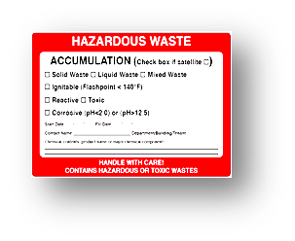
Hazardous Waste
Labeling:
Hazardous waste must be labeled, as described below.
NAME of person responsible for generating waste and their department.
START DATE: the date you first put waste into the container.
FILL DATE: the date you place the full container in the satellite accumulation area.
CONTENTS: The type of waste that was generated – boxes must be checked to include the following:
Type: SOLID or LIQUID or MIXED
Hazard: IGNITABLE/FLAMMABLE, CORROSIVE, TOXIC or REACTIVE.
Name of the ingredient that makes the waste hazardous

Slide 26
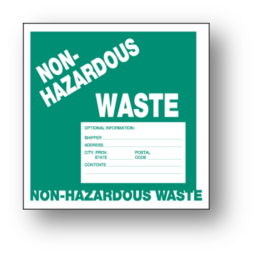
Other Waste
Non-Hazardous Waste:
Doesn’t meet the EPA criteria for Hazardous Waste
Do not pour down drain or put in trash
Label with “Non-Haz” Label and put in SAA
Universal Waste:
Batteries, Lamps & Mercury containing devices ONLY
Label and put in SAA
Indicate type of items (i.e. Bulbs) and date

Slide 27
Satellite Accumulation Area
ALL WASTE IS PLACED IN THE SAA:
Use separate bins to contain waste types (i.e. acids, bases, solvents). Signage is posted at the SAA on what chemicals are compatible and can be mixed
Store only in designated area, do not mix with stock chemicals

Slide 28
Hazardous Chemicals
Chemicals of Concern (commonly used in labs):
Flammables Corrosives
Oxidizers Water Reactive
Pyrophorics Peroxide formers
Toxics Nanomaterials
Specific Chemicals (examples in labs):
Arsenic Formaldehyde Methylene chloride Mercury
Sodium azide HF (hydrogen fluoride)
Perchloric acid Chloroform
TMAH (Tetramethyl ammonium hydroxide)

Slide 29
Work Alone Policy
EHS-00045 Working Alone Policy
Whenever possible – have 2 or more people in the lab when working with chemicals
A “Buddy” is required when working with highly hazardous materials, such as: (partial list)
TMAH, HF, Pyrophoric chemicals
“Buddy” is to call Security and assist worker in case of emergency
PI will determine when a “Buddy” is needed.
Lab Access:
Normal lab access in 7AM – 9PM
For extended access PI must submit request to Access Control. Form in Policy

Slide 30
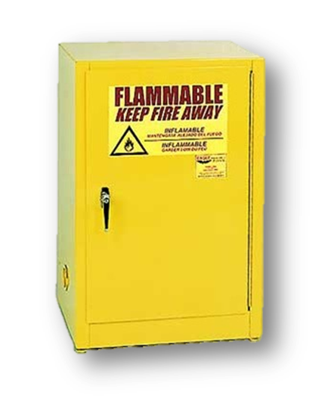
Flammables
Based upon Flash Point (on SDS)
Keep away from ignition sources
Flammable liquids must be stored separately from strong oxidizers, shielded from direct sunlight, and away from heat sources
Approved Storage Locations:
Explosion proof refrigerators. Label as follows:
FOR CHEMICAL STORAGE ONLY
DO NOT STORE FOOD OR BEVERAGES IN THIS REFRIGERATOR
Flammable liquid storage cabinet:
Must be self-closing and grounded
Conspicuously labeled:
“FLAMMABLE – KEEP FIRE AWAY”.

Slide 31
Pyrophoric or Water Reactive Chemicals
A pyrophoric substance will ignite in air at or below 130° F.
Water Reactive materials react exothermically with water, and may produce hazardous gases such as HCL, hydrogen.
Examples: silane, phosphorus, tributylaluminum, lithium compounds
Wear flame retardant lab coat when handling
Store under an atmosphere of inert gas
Handle in a nitrogen purged environment (glovebox or other containment).
Use inerting apparatus in a fume hood
PI will provide additional training
CNSE has specific policies on receipt and transfer of pyrophoric materials

Slide 32
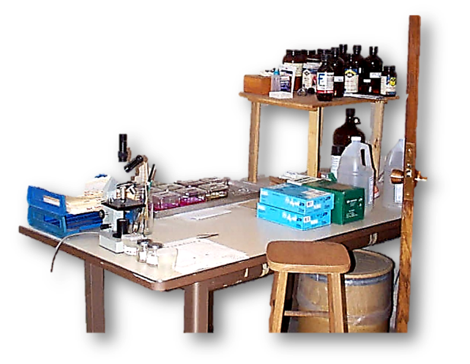
Corrosives
Determined by pH (see SDS)
Corrosives are destructive to human tissue.
Severity of damage depends on concentration of corrosive
Severe exposure may cause permanent damage
Wear gloves when handling corrosives
FIRST AID – Flush a minimum of 15 minutes.
AAA – Always Add Acid to water
Corrosive Storage:
Acids and bases must be segregated. If stored in the same cabinet, use separate plastic trays, tubs or buckets.
Store below eye level

Slide 33
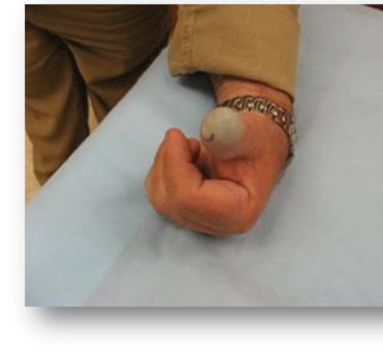
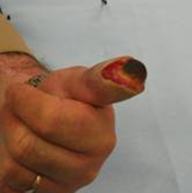
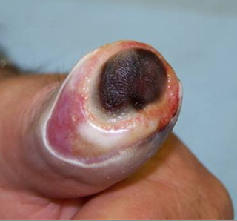
Hydrofluoric Acid (HF)
Causes deep, painful, slow-healing burns
Burns may not be apparent for up to 24 hrs.
Fluoride ion destroys soft tissue & decalcifies bone
Call Security if exposures occur (518)
437-8600
ERTs have calcium gluconate to treat skin contact
Day 1 Day 6 Day 12 90 Days

Slide 34
Tetra Methyl Ammonium Hydroxide (TMAH)
Causes injury or death from skin contact at or above 1% TMAH in water.
SUNY Poly uses TMAH at <1-25%
Required PPE: Chemical resistant gloves, face shield, apron, arm sleeves, goggles
Highly toxic and fast acting
Call security immediately (518)
437-8600
Signs and symptoms
2nd to 3rd degree burns of skin
Irregular breathing and heart beat
Progressing to coma, shock and, in most cases, death

Slide 35
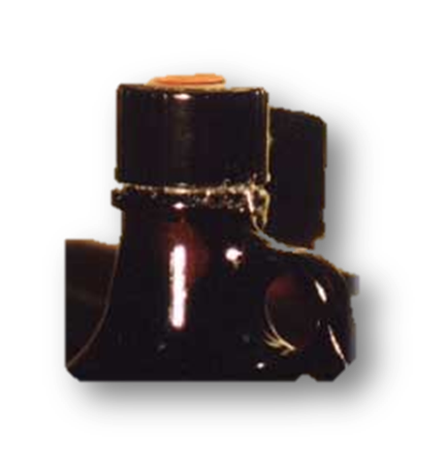
Peroxide Formers
Common peroxides formers include THF, Ethyl ether & dioxanes.
Form (crystals) upon exposure to air and light.
Must be disposed after 1 year
Labels on containers must include:
The date of receipt: (MM/DD/YY)
The date opened: (MM/DD/YY)
Responsible employee (Owner of the material).
“Peroxide Former” or “Peroxidizable”
Classes of peroxide formers

Slide 36
Oxidizers
Includes Perchloric Acid, Hydrogen Peroxide and Silver Nitrate
Initiate or promote combustion of materials
Release oxygen
Keep away from flammable/combustible materials
Allow for venting of vessels – pressurization hazard
For Perchloric Acid
Can NOT be kept for more than 1 year or explosive crystals can form- date bottle upon receipt
Bottle Dating: Receipt, opened and disposal date
Discolored perchloric acid - Call Emergency #.

Slide 37
Toxics
Skull & Crossbones
Acute Toxicity
Able to cause disease, illness or death.
Includes:
Carcinogens - Mutagens
Organ Toxicity - Sensitizers
Reproductive Toxins - Teratogens
Everything can be toxic!
The dose makes the poison
Health Hazard Carcinogen
Exclamation Mark Irritants

Slide 38
Indicators of Toxicity
Levels at which 50% of lab animals expired:
LD50 – Lethal Dose 50%
LC50 - Lethal Concentration 50%
Exposure Limits:
PEL – Permissible Exposure limit
TLV – Threshold Limit Value
STEL – Short term exposure limit
TWA – Time Weighted average
C- Ceiling
The lower the number, the more toxic!!
If you have questions, contact EHS.

Slide 39
Heavy Metals
Arsenic (Arsine):
Must receive additional arsenic training annually. EHS-00052 Arsenic Protection Program
Lung Cancer
Can cause nausea and vomiting, decreased production blood cells, abnormal heart rhythm, damage to blood vessels &“pins and needles” sensation in hands and feet.
Mercury:
Permanently damage the brain, kidneys, and developing fetuses.
May result in irritability, shyness, tremors, changes in vision or hearing, and memory problems.
Short-term exposure may cause lung damage, nausea, vomiting, diarrhea, increases in blood pressure or heart rate, skin rashes, and eye irritation.
Lead:
Damages the brain and kidneys, ultimately causes death.
In pregnant women, high exposure to lead may cause miscarriage.
In men can damage the organs responsible for sperm production
Chromate (hexavalent chrome):
Known human carcinogen
can cause damage to liver, kidney, circulatory and nerve tissues, as well as skin irritation.
Cadmium:
Severely irritates the stomach (vomiting and diarrhea)
Chronic: buildup in the kidneys and possible kidney disease, lung damage and fragile bones.

Slide 40
Chlorinated Solvents:
Includes Chloroform and Methylene Chloride (MC)
Causes dizziness, fatigue, headache & nausea
Irritating to skin and eyes - chloracne
Possible human carcinogen
Not combustible, but if burned can create toxic gases (HCL and phosgene)
Poor warning properties
MC: OSHA PEL= 25 ppm, TLV=10, odor threshold=135ppm
Chloroform: OSHA PEL=50 ppm, TLV=25, odor threshold=150ppm

Slide 41
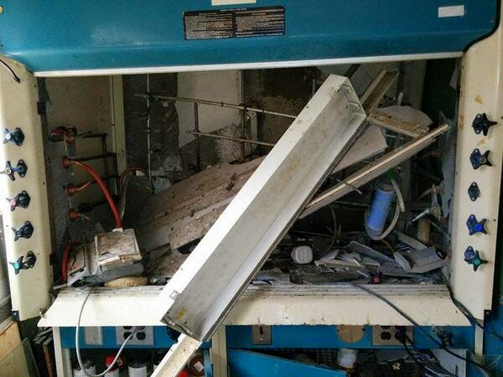
Other Commonly Used Toxics
Formaldehyde & Formalin
Highly irritating gas (dissolved in water)
Human Carcinogen (throat)
OSHA limit of 0.75ppm PEL & 2ppm STEL
Sodium Azide
Highly toxic – effects CNS and brain
In water forms Hydrazoic acid – Inhalation hazard
Explosion hazard (reaction with CH2Cl2)
Ethidium Bromide
Strong Mutagen
Irritant
Phenol
Very toxic by skin absorption (fatal)
Damage to CNS, Liver and kidneys
Causes severe burns – may not be felt immediately
It sounds like a possible culprit may have been hydrazoic acid.

Slide 42
Piranha
Also known as SPM (Sulfuric Peroxide Mix)
Piranha is a solution of sulfuric acid and hydrogen peroxide used for cleaning wafers
Piranha is corrosive
Required PPE: Acid gloves, face shield, goggles, sleeves/apron or impermeable
coat
Reaction is exothermic
Disposal requirements:
Cool solution for at least 1 hour
Put in a high density plastic jug
with vented cap.
Haz Waste Label: corrosive & reactive
Name
Date
Piranha

Slide 43
Additional Safety Training
Based upon your duties in the lab:
*Arsenic - Online
Biosafety and *Bloodborne Pathogens- Online via CITI
Compressed gas cylinder - Online
Cryogens - Online
*Radiation – Online or in-class
*Lasers (Class 3b or 4) – Online
*Hazardous Waste - Online
Additional training may be provided by Academic Engineering Support Group
* Required annually

Slide 44
EHS Intranet Page
Request a
Chemical
Online
Training
Send an
e-mail

Slide 45
Additional Resources
EHS Dept. and Policies
YOUR Principle Investigator
Lab Specific Chemical Hygiene Plan (in Lab)
Prudent Practices in the Laboratory (National Research Council) http://nap.edu/12654
Hazardous Chemical Handbook
Biosafety in Microbiological and Biomedical Laboratories 5th Edition (CDC)
CRC Handbook of Lab Safety 5th Edition

Slide 46
Close
SUNY Poly is committed to providing you a safe working environment
You are a key player in this effort
All individuals on-site are expected to share this commitment
Each of us must comply with safety and environmental laws and SUNY Poly safety requirements
Thank you in advance for your support and efforts toward environmental, health and safety at SUNY Poly and in the laboratory

